Slide 1
Exam and QKD – 19th Nov 2020
Learn Quantum Computation using Qiskit

Slide 2
Agenda
8:15-9:00 Exam – multiple choice questions
9:00-9:15 Break
9:15-10:00 Exam – the rest
10:00-10:15 Break
10:15-11:00 5 pages reports
11:00-11:05 Break
11:05-11:30 Quantum Key Distribution BB84

Slide 3
Multiple Choice links
https://jackkrupansky.medium.com/questions-about-quantum-computing-924772c72c44
https://quizizz.com/admin/quiz/5dd6efc976ef01001bcb3b95/quantum-computers
https://diagnosticquestions.com/Quantum

Slide 4

1. Motivation and Introduction
What? Why?

Slide 5
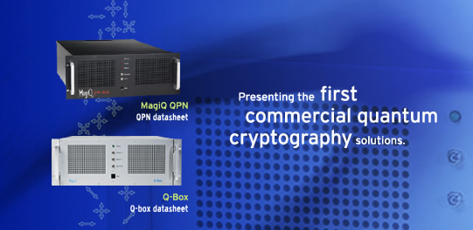
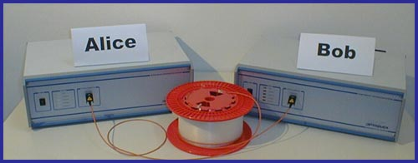
Commercial Quantum Crypto products available on the market Today!
MAGIQ TECH.
Distance over 100 km of
commercial Telecom fibers.
ID QUANTIQUE

Slide 6
Bad News (for theorists)
Theory of quantum key distribution (QKD) is behind experiments.
Opportunity:
By developing theory, one can bridge gap between theory and practice.

Slide 7
Happy Marriage
Theory and Experiment go hand in hand.

Slide 8
Key Distribution Problem
Eve
Alice
Bob
Alice and Bob would like to communicate in absolute
security in the presence of an eavesdropper, Eve.
To do so, they need to share a common random string
of number----key

Slide 9
Bennett and Brassard’s scheme (BB84)
Alice
Bob
ASSSUMPTIONS:
Source: Emits perfect single photons. (No multi-photons)
Channel: noisy but lossless. (No absorption in channel)
Detectors: a) Perfect detection efficiency. (100 %)
Basis Alignment: Perfect. (Angle between X and Z basis is exactly 45 degrees.)
Assumptions lead to security proofs:
Mayers (BB84), Lo and Chau (quantum-computing protocol),
Biham et al. (BB84), Ben-Or (BB84), Shor-Preskill (BB84), …
Conclusion: QKD is secure in theory.

Slide 10
Reminder: Quantum No-cloning Theorem
An unknown quantum state CANNOT be cloned. Therefore, eavesdropper, Eve, cannot have the same information as Bob.
Single-photon signals are secure.
a
a
a
IMPOSSIBLE
Notes:
Quick/skip

Slide 11
Photon-number splitting attack against multi-photons
A multi-photon signal CAN be split. (Therefore, insecure.)
a
a
a
Bob
Splitting attack
a
Alice
Eve
Summary: Single-photon good.
Multi-photon bad.

Slide 12
QKD : Practice
Reality:
1. Source: (Poisson photon number distribution)
Mixture. Photon number = k with probability:
Some signals are, in fact, double photons!
Channel: Absorption inevitable. (e.g. 0.2 dB/km)
Detectors:
(a) Efficiency ~15% for Telecom wavelengths
(b) “Dark counts”: Detector’s erroneous fire.
Detectors will claim to have detected signals with
some probability even when the input is a vacuum.
4. Basis Alignment: Minor misalignment inevitable.
Question: Is QKD secure in practice?

Slide 13
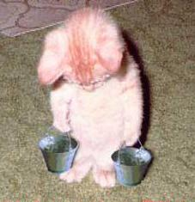
2. Problem
Help!

Slide 14
Big Problem: Nice guys come last
Alice:
Problems: 1) Multi-photon signals (bad guys) can be split.
2) Eve may suppress single-photon signals (Good guys).
Bob:
Eve:
Eve may disguise herself as absorption in channel.
QKD becomes INSECURE as Eve has whatever Bob has.
Signature of this attack: Multi-photons are much more likely to reach Bob than single-photons.
(Nice guys come last).

Slide 15
Yield as a function of photon number
Let us define Y_{n} = yield
= conditional probability that a signal
will be detected by Bob, given that it is
emitted by Alice as an n-photon state.
Bob:
Eve:
For example, with photon number splitting attack:
Y₂ = 1 : all two-photon states are detected by Bob.
Y₁ = 0 : all single-photon states are lost.

Slide 16
Figures of merits in QKD
# of Secure bits per signal (emitted by Alice).
How long is the final key that Alice and Bob can generate?
(Maximal) distance of secure QKD.
How far apart can Alice and Bob be from each other?

Slide 17
Prior Art Result
Consider the worst case scenario where all signals received by Bob are bad guys. (Insecure.)
To prevent this from happening, we need:
# of signals received by Bob
> # of multi-photon signals emitted by Alice.
Consider channel transmittance η.
For security, we use weak Poisson photon number
distribution: μ = O (η).
Secure bits per signal S = O (η²).

Slide 18
Big Gap between theory and practice of BB84
Theory Experiment
Key generation rate: S = O (η²). S= O (η).
Maximal distance: d ~ 35km. d >120km.
Prior art solutions (All bad):
Use Ad hoc security: Defeat main advantage of Q. Crypto. : unconditional security. (Theorists unhappy ☹.)
Limit experimental parameters: Substantially reduce performance. (Experimentalists unhappy ☹.)
Better experimental equipment (e.g. Single-photon source. Low-loss fibers. Photon-number-resolving detectors): Daunting experimental challenges. Impractical in near-future. (Engineers unhappy ☹.)
Question: How can we make everyone happy ☺?

